Slide 1

Name-Akshay Vinayak Course-B.Tech (CSE) Year-2016-2020 Sem-4th Enrolment No-91005216081 NTCC-Non Teaching Credit Course

Slide 2
BACHELOR THESIS ON:
CLOUD COMPUTING
Under the Supervisor
Prof. Sudip Chatterjee
Faculty, Dept. Of CSE, Amity University Kolkata

Slide 3
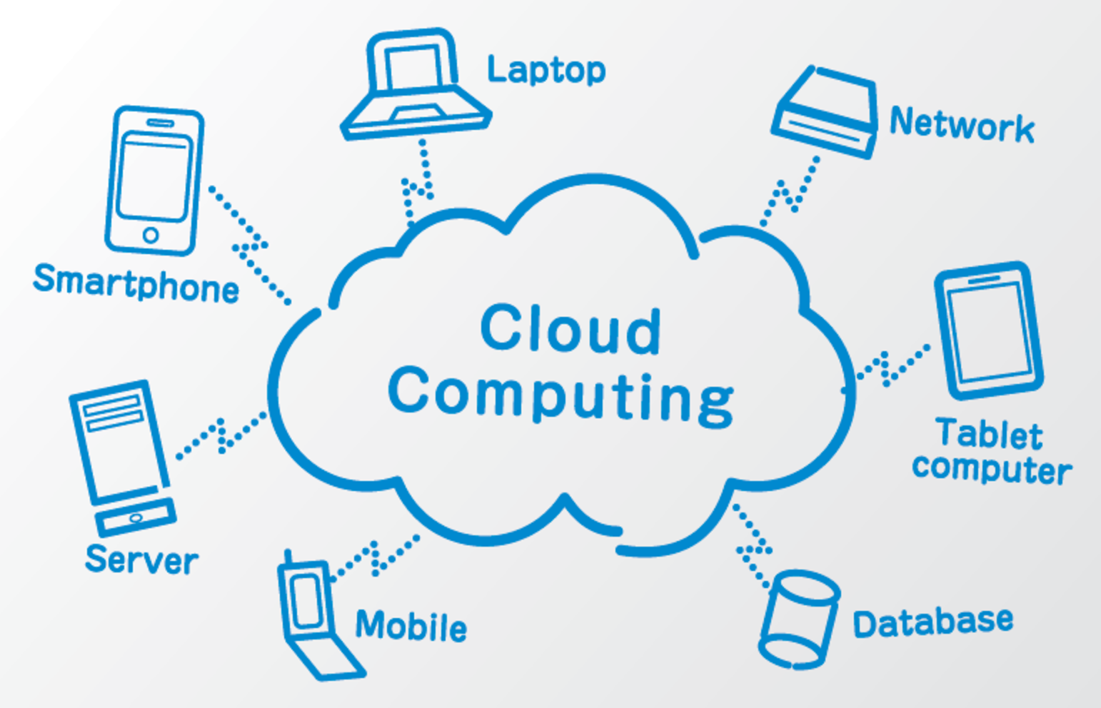
What is CLOUD COMPUTING?
Cloud computing is more than a service sitting in some remote data centre. It is a set of approaches that can help organizations quickly, effectively add and subtract resources in almost real time.

Slide 4
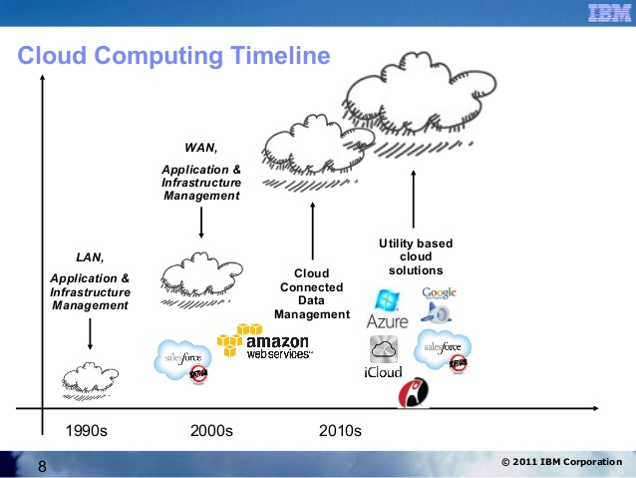
Leap to the HISTORY
Cloud computing is older than it seems;

Slide 5
GRASPING FUNDAMENTALS
Many players make up the world of cloud computing:
The vendors providing applications and enabling technology, infrastructure, hardware, and integration.
The partners of these vendors that are creating cloud services offerings and providing support services to customers.
The business leaders themselves who are either using or evaluating various types of cloud computing offerings.

Slide 6
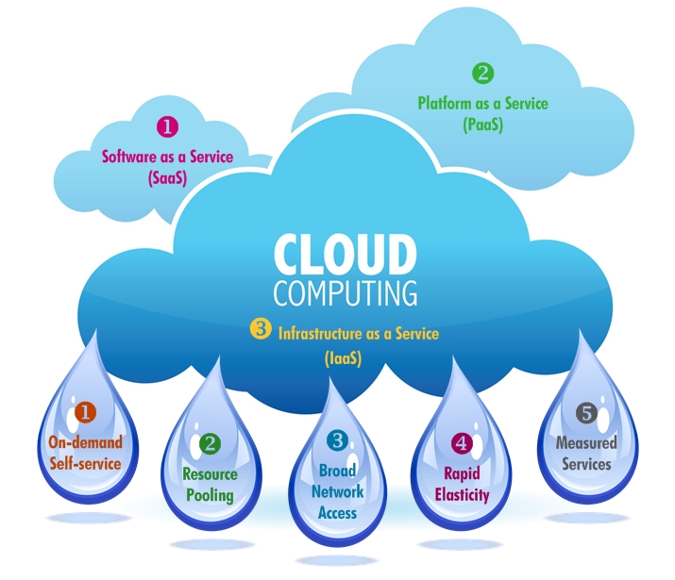
CHARACTERISTICS OF CLOUD

Slide 7
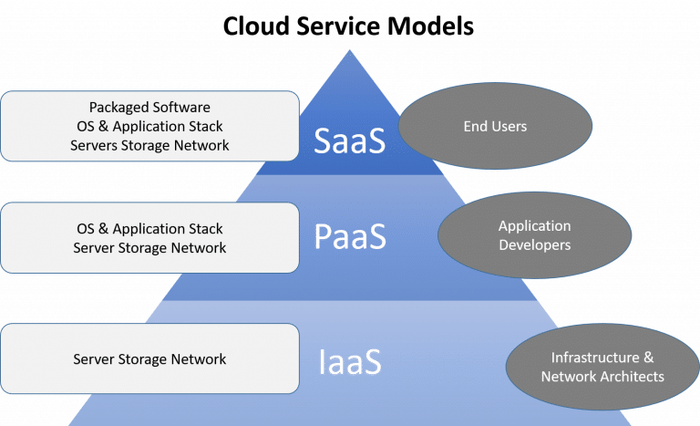
CLOUD SERVICES

Slide 8
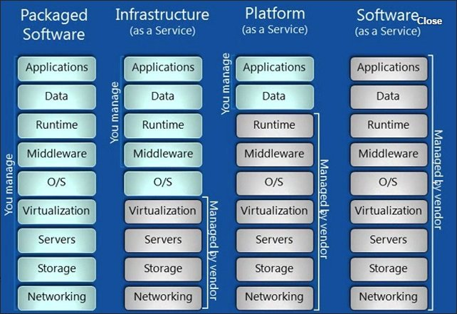

Slide 9
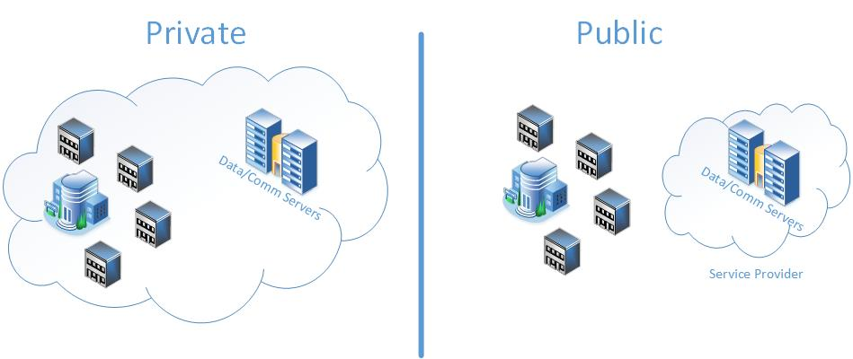
CLOUD DELIVERY MODELS

Slide 10
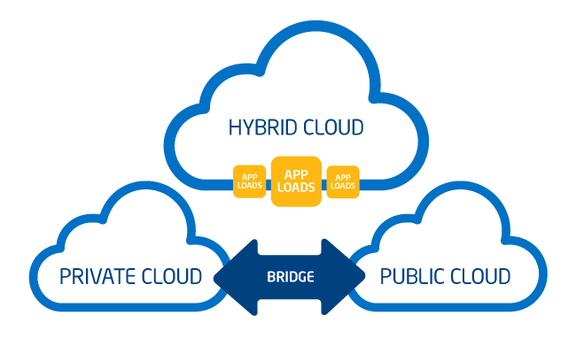
Hybrid cloud is a cloud computing environment that uses a mix of on-premises, private cloud and third-party, public cloud services with orchestration between the two platforms.

Slide 11
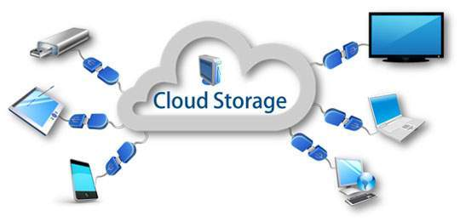
APPLICATIONS OF CLOUD COMPUTING
Some of real world Applications of cloud computing is as follows:
CLOUD STORAGE
Dropbox
Gmail
Facebook

Slide 12
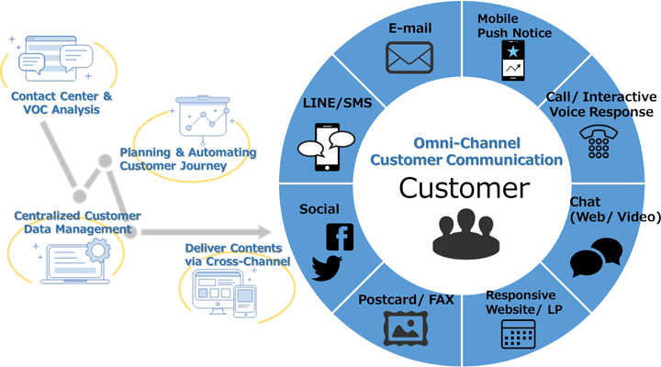
MARKETING CLOUD PLATFORMS
Maropost marketing cloud
Hubspot
Adobe marketing cloud

Slide 13
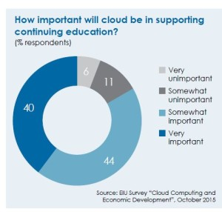
CLOUD COMPUTING IN EDUCATION
Slide rocket
Rat type
Amazon

Slide 14
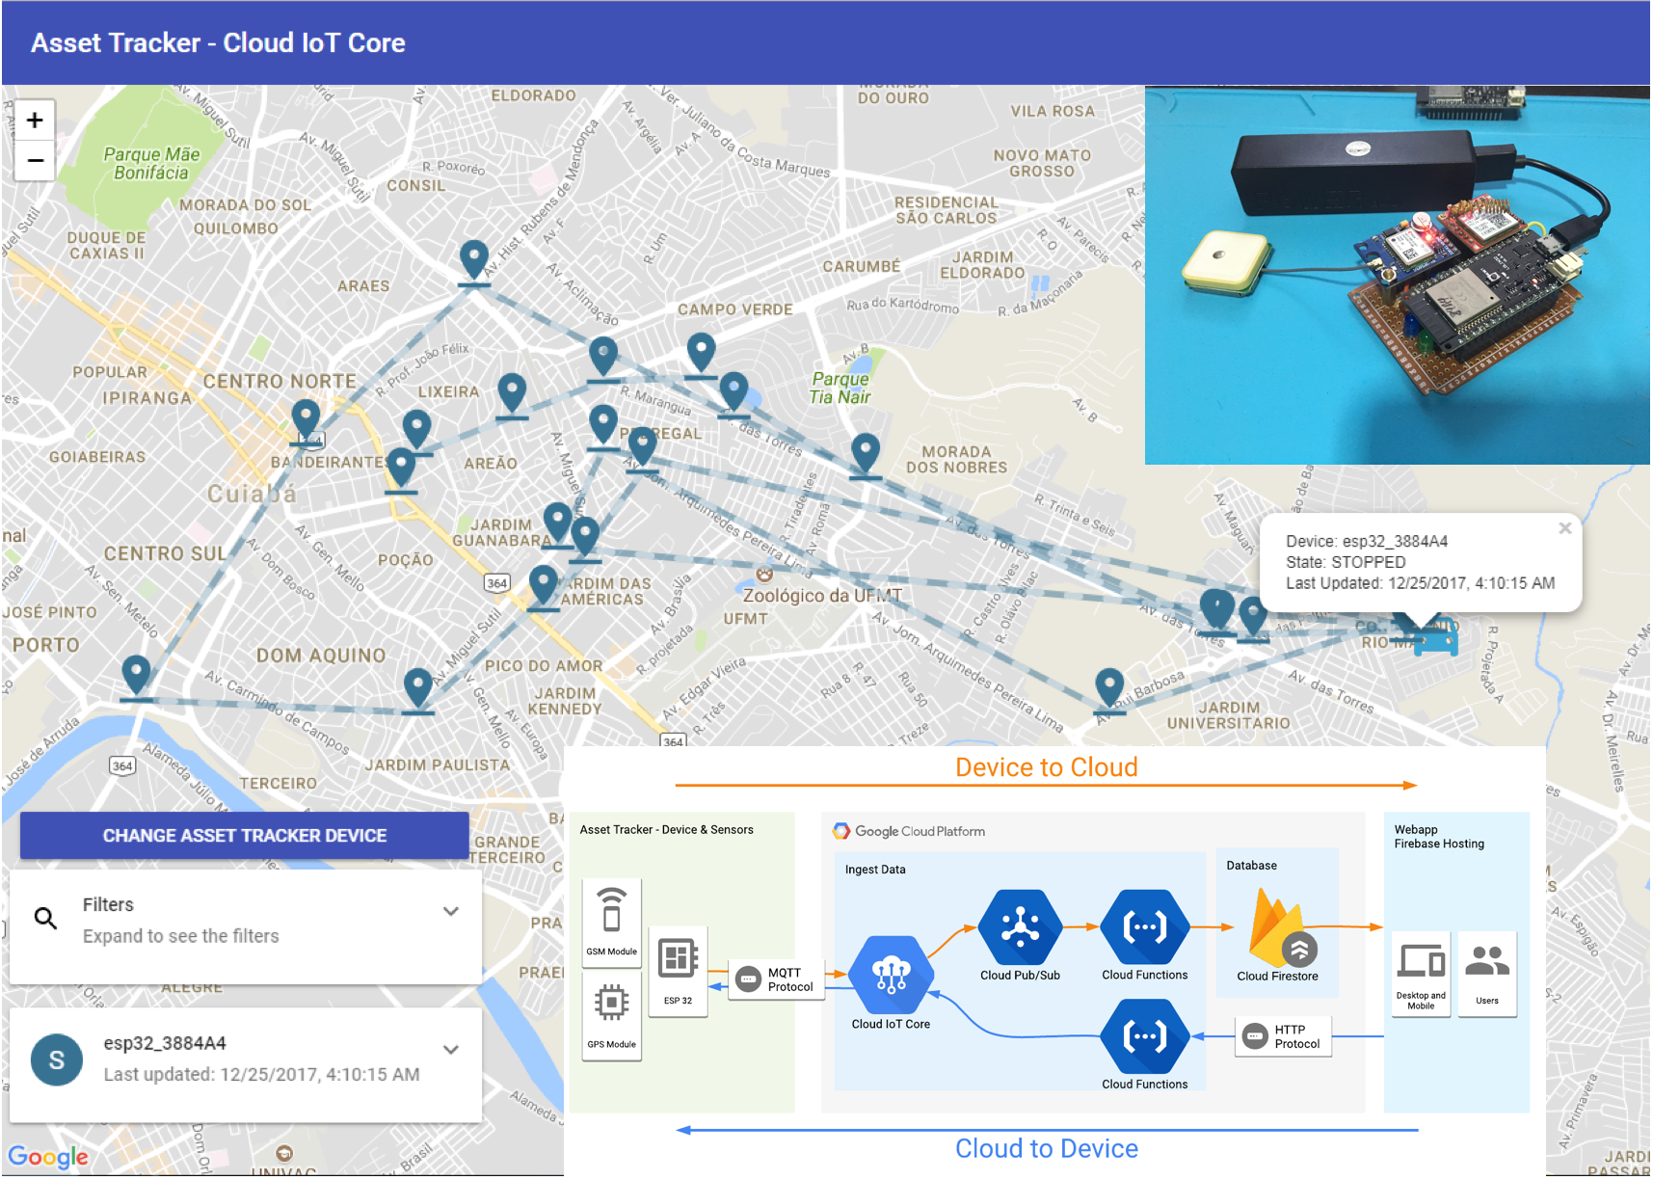
WEATHER AND POLLUTION REPORT IN AN INSTANT (REAL TIME APPLICATION)

Slide 15
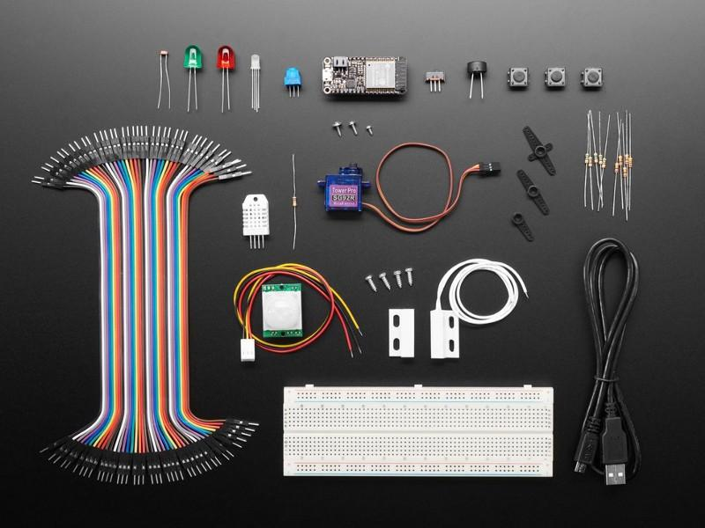
IOT AN APPLICATION OF CLOUD COMPUTING (BASICS & ADVANCED)
THINGS REQUIRED

Slide 16
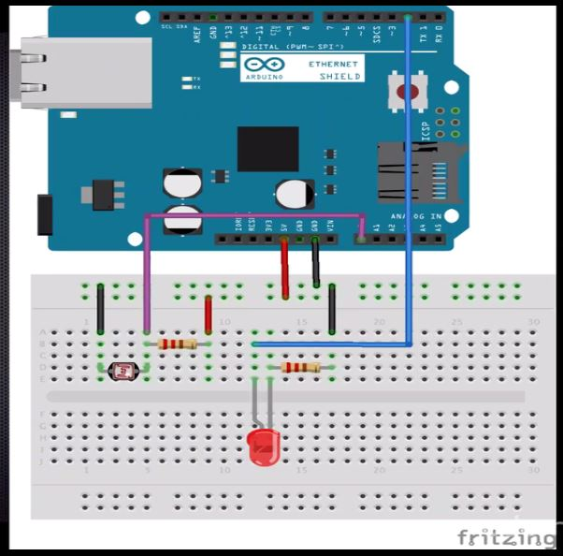
Glowing of LED on server via Ethernet
CIRCUIT DIAGRAM

Slide 17


Slide 18
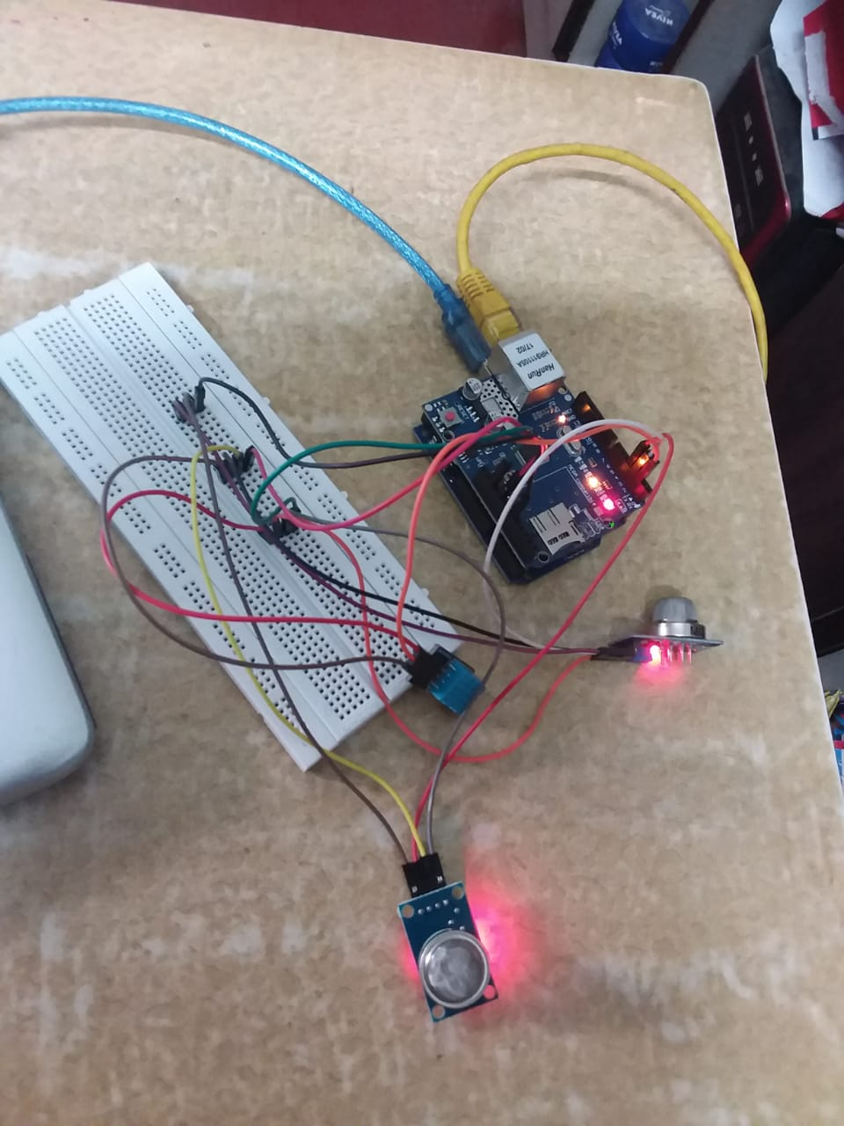
Pollution check on server via Ethernet

Slide 20
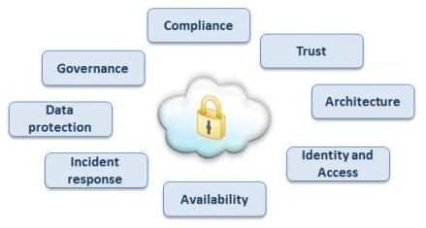
SECURITY AND GOVERNANCE OF CLOUD

Slide 21
LIMITATIONS
Basically the main project is all about the pollution sensing which senses the different kind of pollution that is gas, smoke and various other things. This was a small scale project done. On a larger scale project it can have many more sensors like particulate sensors and ozone gas, fire and NO₂ sensor.
This project on a larger scale can have 5 to 6 Arduino(s) connected to the same server via Wi-Fi and the data readings taken at every interval of time. If any large change is sensed then it will send you an e-mail or will notify you. The data collected on the large scale can be analyzed as well and to save the environment by knowing the rising change in the environment.

Slide 22
THANK YOU

